Slide 1
Hidden Surface Removal (Visible Surface Detection)
Major concern for realistic graphics is identifying those pars of a scene that are visible from a chosen viewing position
Object Space Methods ( OSM )
- OSM compares objects and parts of object to each other within the scene definition to determine which surfaces as a whole we should label as visible e.g. Back Face Detection method
Image Space Method ( ISM )
- ISM decides point by point at each pixel position and is most widely used.

Slide 2
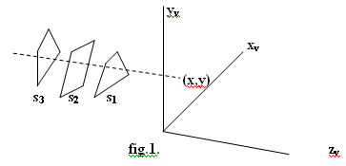
Z-buffer or Depth buffer Method:
Commonly used ISM
Since object depth is usually measured from the view plane along the z axis of a viewing surface, each surface of a scene is processed separately , one point at a time across the surface
Usually for polygon surface, because depth values can be computed very quickly and the method is easy to implement and can apply to non planar surfaces.
Implementing the algorithm in normalized coordinates , z value ranges from 0 at the back clipping plane to z_{max} at the front clipping plane.

Slide 3
Z-buffer or Depth buffer Method:
Algorithm:
i. Initialize the depth buffer and refresh buffer so that for all buffer position (x,y)
depth(x,y) = 0 or (zmin) and refresh(x,y) = Ibackground
ii. For each position on each polygon surface compare depth
values to previously stored values in the depth buffer to
determine visibility
Calculate the depth ‘z’ for each (x,y) position on the polygon
iii. If z > depth(x,y) then set
depth = z and refresh(x,y) = Isurface (x,y)
where Ibackground (x,y) is background intensity , Isurface (x,y) is projected intensity value for surface at pixel position (x,y)

Slide 4
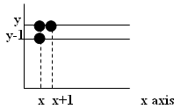
Hidden Surface Removal (Visible Surface Detection)
After all surfaces have been processed the depth buffer contains depth values for the visible surfaces and the refresh buffer contains the corresponding intensity values for those surfaces
  Depth value for a surface position (x, y) is
  z = (-Ax –By – D)/c …………………(i)
  Let depth z’ at (x + 1 , y)
  z’ = -A(x+1) – By – D/c or z’ = z – A/c………..(ii)

Slide 5
Hidden Surface Removal (Visible Surface Detection)
Now since (-A/c) is constant for each surface, so succeeding depth values across a scan-line are obtained from preceding values with a simple mathematics.
On each scan-line , we start by calculating depth on a left edge of the polygon that intersect that scan-line (fig ii) ‘z’ at each successive position across the scan line are the calculated by equation z’ = -A(x+1) – By – D/c or z’ = z – A/c………..(ii)

Slide 6
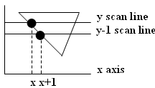
Hidden Surface Removal (Visible Surface Detection)
first determine y coordinate extents of each polygon y scan line and process from top scan to bottom scan starting y-1 scan line at a top vertices we can recursively calculate ‘x’ position
down a left edge of the polygon as
x’ = x - 1/ m where m is the slope of edge fig (iii)
‘z’ values down the edge are then obtained recursively as figure.
z’ = z + (a/m + b) /c or z’ = z + b/c as m → for vertical edge

Slide 7
Scan-line Method
ISM for removing hidden surfaces is an extension of the scan-line algorithm for filling polygon interiors.
Instead of filling just one surface we consider multiple surfaces.
As each scan-line is processed all polygon surfaces intersecting that line are examined to determine which are visible
We assume that tables (polygon) are set up for the various surfaces (edge, polygon etc)

Slide 8
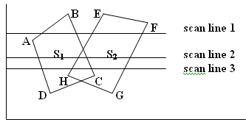
Scan-line Method
Polygon table contains coefficients of the plane equation for each surface intensity information for the surfaces and possible pointers into the edge table
Active edge list for scan-line1 contains scan line 1 information from the edge table for edges AB,BC,EH AND FG

Slide 9
List Priority Algorithms
Determines a visibility ordering for objects ensures that a correct picture results if objects are rendered in that order.
e.g. if no object overlaps in ‘z’ then we need only to sort objects by increasing ‘z’ and render them in that order.
Farther objects are obscured by closer ones as pixels from the closer polygons overwrite those of more distant ones.
If objects overlap in ‘z’, we may still be able to determine a correct order.
If objects cyclically overlap, or penetrate each other, then there is no correct order.

Slide 10
List Priority Algorithms
Hybrids that combine both object and image precision operations.
Depth comparison and object splitting are done with object precision.
Scan conversion (which relies on ability of graphics device to overwrite pixels of previously drawn objects) is done with image precision.

Slide 11
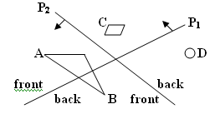
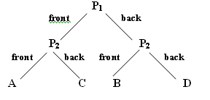
A. BSP TREE METHOD
Binary Space partitioning (BSP) tree is an efficient method for determining object visibility by painting surfaces onto the screen from back to front, as in painter’s algorithm
Useful when view reference point changes but the objects in a scene are at fixed position
Identifying surfaces that are “inside” and “outside” partitioning plane at each step of space sub division relative to viewing direction is required for visibility testing.

Slide 12
B. Depth sorting Method
Makes use of both image and object space operations to:
i. Sort surfaces in decreasing depth order (using both image and object space)
ii. Scan converted in order starting with surface with greatest depth (using image space)
Also referred to as painters algorithm because an artist first paints background color then most distant object then nearer object and so on.
In the end the foreground objects are painted on canvas over the background. Each layer of paint covers up previous layer

Slide 13
B. Depth sorting Method
Similarly, we first sort surfaces according to their distance from view plane.
Intensity values for farthest surface are entered into refresh buffer.
Taking each surface in turn (in decreasing depth order) we paint surface intensities onto frame buffer over intensity of previously processed surface

Slide 14
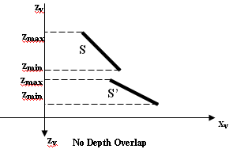
B. Depth sorting Method
We assume we’re viewing along ‘z’ direction. Surfaces zmax are ordered according to largest ‘z’ value on each surface zmin
Surface with greatest depth is compared with other zmax surface in list to see if there are any overlaps in depth zmin
If no depth overlap then surface S is scan converted

Slide 15
B. Depth sorting Method
Additional test are required for each surface in case of depth overlap with surface S:
i. Bounding rectangle in xy plane for two surfaces don’t overlap
ii. Surface S is completely behind overlapping surface relative to viewing
position
iii. Overlapping surface S’ is completely in-front of S relative to viewing
position
iv. Projection of 2 surfaces onto view plane don’t overlap.
If any of these conditions is true then no reordering of surfaces
is necessary. i.e. if all surfaces pass at least one of the tests then
none of those surfaces are behind S.

Slide 16
B. Depth sorting Method
Similarly, we first sort surfaces according to their distance from view plane.
Intensity values for farthest surface are entered into refresh buffer.
Taking each surface in turn (in decreasing depth order) we paint surface intensities onto frame buffer over intensity of previously processed surface

Slide 17
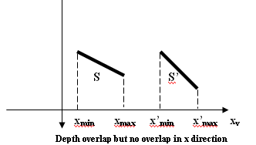
B. Depth sorting Method
For test ( i)
Perform two steps to check overlap first in ‘x’ then in ‘y’ direction.
If either of these directions show no overlap S is completely behind then the two planes cannot obscure one another.

Slide 18
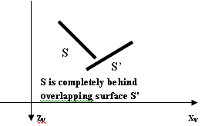
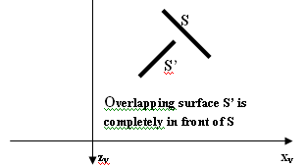
B. Depth sorting Method
For tests (ii) and (iii),
Perform inside outside polygon test.
Substitute coordinates for all vertices into plane equation for overlapping
surfaces and check the sign of the result obtained.
Based on plane equation if all vertices of S are inside S’ then S is completely behind S’.
Similarly, S’ is completely in-front of S if all vertices of S are outside of S’.

